Slide 1
Cybercrime investigation & forensic ii
CYS340

Slide 2
Digital forensics | overview
Lecture 1

Slide 3
Introduction
Cybercrime is any illegal or criminal activity carried out by means of computers or the internet.

Slide 4
Cybercrime investigators
Cybercrime investigators are law enforcement professionals who specialize in investigating computer-related crimes.
According to Act no. 2 of 2021 PART I (Preliminary Provision) “Law Enforcement” means –
a police officer above the rank of sub-inspector;
an officer of the Anti-Corruption Commission;
an officer of the Drug Enforcement Commission;
an officer of the Zambia Security Intelligence Service; and
any other person appointed by the Minister for purposes of this Act;

Slide 5
Cybercrime investigators (continues…)
They use their knowledge of computer science, law, and investigative techniques to gather evidence and identify suspects.
Cybercrime investigators may work for law enforcement agencies, government agencies, or private companies.
Their job duties may include conducting investigations, preparing reports, and providing testimony in court.

Slide 6
Cybercrime investigation
Is the process of using digital forensics to identify and prosecute cybercriminals, or
Is the process of identifying, analyzing, and mitigating computer-based crimes and other forms of malicious activity that occur in cyberspace.
It involves the use of specialized tools and techniques to investigate various types of cybercrimes, such as hacking, phishing, malware, data breaches, and identity theft.

Slide 7
Top 5 Cybercrimes
Phishing and Scam
Phishing is a form of social engineering and a scam where attackers deceive people into revealing sensitive information or installing malware such as viruses, worms and trojans through attachments or links sent via email by impersonating a legitimate organization or entity.
Scam is a dishonest scheme; a fraud, similar to swindle, trick, etc.

Slide 8
Top 5 Cybercrimes (Continues…)
Identity Theft
The fraudulent practice of using another person's name and personal information in order to obtain credit, loans, etc.
Ransomware Attack
Is a type of malware that encrypts the victim's personal data until a ransom is paid.

Slide 9
Top 5 Cybercrimes (Continues…)
Hacking/Misusing Computer Networks
The gaining of unauthorized access to data in a system or computer.
Internet Fraud
Also known as online fraud, refers to any deceptive practice that uses the internet to trick individuals or businesses into giving up personal information, money, or property, often by presenting false offers, scams, or misleading information through emails, websites, or online platforms to gain financial advantage.

Slide 10
PROTECTING AGAINST CYBERCRIMES
It is important for businesses and individuals to take proactive measures to protect against these types of cybercrimes, such as implementing strong security measures and staying vigilant against suspicious activity.
Installing and regularly updating anti-virus software
Use Multi-factor authentication (MFA)
Use strong passwords

Slide 11
Types of Cyber Criminals
Hackers /Attackers
Individuals who use their expertise to gain unauthorized access to computer systems or networks for various reasons such as stealing data or causing damage.
They can be motivated by financial gain, political or social causes, or simply a desire to test their skills.

Slide 12
Types of Cyber Criminals (continues…)
Insiders
Individuals who have authorized access to computer systems or networks but misuse their access for personal gain or to harm the organization.
Organized Crime Groups
Groups of individuals who engage in cybercrime for financial gain or other criminal activities.

Slide 13
Types of Cyber Criminals (continues…)
National / States
Governments or state-sponsored groups use cyber-attacks for political or military purposes.
Nation-states can use cyber-attacks to gather intelligence, disrupt systems, or gain a strategic advantage over other countries.

Slide 14
Types of Cyber Criminals (continues…)
Cyberterrorists
Individuals or groups that use cyber-attacks to cause fear, disrupt systems, or harm individuals or organizations.
They can be motivated by political or social causes.

Slide 15
Digital forensics
Cybercrime investigation techniques involve a combination of technical and non-technical methods for gathering evidence and identifying suspects.
One of the most important techniques used in cybercrime investigation is digital forensics.
Digital forensics involves the collection, preservation, and analysis of digital evidence.

Slide 16
Digital forensics (continues…)
Digital forensics can include;
The recovery of deleted files,
analyzing metadata, and
examining network traffic logs.

Slide 17
Cybercrime Investigation Techniques
Conducting interviews with witnesses
Reviewing surveillance footage
Analyzing financial records to track the flow of money
Use social engineering techniques to gather information about suspects, such as posing as potential victims or using fake social media profiles to gain access to information.
Collaboration and Specialization Unit – Cybercrime investigations often involve multiple agencies and organizations, and it's important for investigators to work together to share information and resources.
Digital Forensics

Slide 18
Cybercrime Investigation Tools
Digital Forensic Software
Network Analysis Tools
Malware Analysis Tools
EnCase
FTK
Autopsy
Wireshark
Tcpdump
Netscout
IDA Pro
OllyDbg
Binary Ninja

Slide 19
Cybercrime Investigation Tools (Continues…)
Password Recovery Tools
Social Media Analysis Tools
Cain
Abel
John the Ripper
Hashcat
Hootsuite
Followerwonk
Mention

Slide 20
Digital forensics
Lecture 2

Slide 21
Introduction
Forensics is the scientific analysis of people, places and things to collect evidence during crime investigations, that helps to prove innocence or guilt in court, or
Is the art and science of investigating digital crimes and breaches.
Computer forensic (digital forensics or cyber forensics) is a branch of digital forensic science that uses technology and investigative techniques to analyze data from computer systems, networks, wireless communications, and storage devices.

Slide 22
Characteristics of Computer Forensics
Identification and Collection (Acquisition) – Involves identifying and collecting digital evidence from electronic devices.
Preservation – Involves creating working copies (forensic images) and isolating or securing digital devices from unauthorized access.
Overview – Involves choosing the right method and approach for analysis.
Analysis – Involves the examination of data to extract relevant information in order to collect facts.
Reporting – Involves the documentation and presentation of evidence to legal bodies.

Slide 23
Need for Digital Forensic
It helps the companies gather important information on their computer systems or networks potentially being compromised.
To produce evidence in the court, which can lead to the punishment of the culprit.
Efficiently tracks down cyber criminals from anywhere in the world.
Helps to protect the organization’s money and valuable time.

Slide 24
DIGITAL INVESTIGATION RULES AND REGULATIONS
Preservation of Evidence – No possible evidence is damaged, destroyed, or compromised by the forensic procedures used to investigate the computer.
Prevention of Contamination of Evidence – No possible computer malware is introduced to the computer being investigated during the analysis process.
Accountability of Evidence – A continuing chain of custody is established and maintained.
Ethics of Investigation – Details of the client-attorney relationship are not disclosed if obtained during a forensic process in order to maintain professional ethics and legality.
Normal operations are affected for a limited period of time, if at all.

Slide 25
ROLES & Uses of Digital Forensic
Criminal Prosecutors | Civil Litigations | Insurance Companies | Large Corporations | Law Enforcement | Any Individual
Child Pornography cases | Fraud | False Accident Reports | Embezzlement |  | Sexual harassment
Homicides | Copyright | Workman’s Compensation Cases | Insider Trading |  | Age discrimination
Embezzlement | Divorce |  |  |  | Wrongful termination from job
Financial Fraud | Breach of Contract |  |  |  | Background checks

Slide 26
Key Steps in a Forensic Investigation
Initial Response – The investigation is initiated the moment the computer crime is suspected.
Photographing The Crime Scene – The immediate response is to collect preliminary evidence.
Court Warrant – A court warrant for seizure (if required) is obtained.
First responder procedures are performed.
Seizure – Evidence is seized at the crime scene. After seizure, the evidence is numbered and safely secured.
The evidence is securely transported to the forensic laboratory.
Creating Forensic Disk Images – Two bit-stream copies of the evidence are created. The original disk must not be tampered with as it might change the time stamps.

Slide 27
Key Steps in a Forensic Investigation (Continues…)
Generate Hash Value (s) – An MD5/SHA-256 checksum is generated on the images.
Prepare a Chain of Custody – Any change to this chain calls into questioning the admissibility of the evidence.
Prepare a Forensic Report – It describes the forensic method (s) and recovery tools used.

Slide 28
Tasks That are performed by Forensic Investigator
Data Recovery – Recovers data of investigative value from computers involved in crimes.
Secure The Evidence – Ensures that the evidence is not damaged in any way.
Creating Forensic Image (s) – Creates an image of the original evidence without tampering with it to maintain the original evidence’s integrity.
Prepares a Forensic Report
Provides Expertise Testimony – Addresses the issue in a court of law and attempts to win the case by testifying in court.

Slide 29
Locard's Exchange Principle
States “in the physical world, when perpetrators enter or leave a crime scene, they will leave something behind and take something with them”.
Examples include DNA, latent prints, hair, and fibers.
In digital forensics, registry keys and log files can serve as footprints left by the perpetrator (s).

Slide 30
ORGANIZATIONS INVOLVED IN DIGITAL FORENSICS
Scientific Working Group on Digital Evidence (SWGDE) of 1998
Is made up of “federal government agency, state or local law enforcement agency involved in the digital and multi-media forensic profession”.
The federal Bureau of Investigation has supported formation of:
Scientific Working Groups (SWGs)
Technical Working Groups (TWGs)
Scientific Working Group for DNA Analysis Methods (SWGDAM)
Scientific Working Group for Firearms and Toolmarks (SWGGUN)

Slide 31
ORGANIZATIONS INVOLVED IN DIGITAL FORENSICS (Continues…)
American Academy of Forensic Sciences (AAFS)
Members of the Academy work for:
National Institute of Standards and Technology (NIST)
National Academy of Sciences (NAS).
Scientific Working Group on Digital Evidence (SWGDE).
It has approximately six thousand members and is divided into “eleven sections spanning the forensic enterprise.”

Slide 32
ORGANIZATIONS INVOLVED IN DIGITAL FORENSICS (Continues…)
American Society of Crime Laboratory Directors/Laboratory Accreditation Board
Is the “oldest and most well known crime/forensic laboratory accrediting body in the world.”

Slide 33
ORGANIZATIONS INVOLVED IN DIGITAL FORENSICS (Continues…)
National Institute of Standards and Technology (NIST) of 1901
It was the first federal physical science research laboratory.
It is heavily involved in digital forensics. Some of the programs and projects include:
National Initiative Cyber Security Education (NICE)
National Software References Library
Computer Forensic Tool Testing

Slide 34
ORGANIZATIONS INVOLVED IN DIGITAL FORENSICS (Continues…)
American Society for Testing and Materials (ASTM) of 1898
Comprises about 30,000 members broken into 141 committees.
The Forensics Sciences committee (E30), is further divided into several subcommittees.
The Digital and Multimedia Evidence (E30.12)

Slide 35
Computer/Digital Forensics Tools
The goal of Computer forensics is to perform crime investigations by using evidence from digital data to find who was the responsible for that particular crime.
Digital Forensics Framework (DFF) – Open Source
Has a command line and graphical interface.
Is used to investigate hard drives, volatile memory, create reports about user and system activities.
Can also be used for digital chain of custody, to access the remote or local devices, forensics of Windows or Linux OS, recovery of hidden deleted files, quick search for files’ meta data, and various other things.

Slide 36
Computer/Digital Forensics Tools (continues…)
Bulk Extractor (DFF)
Scans the disk images, file or directory of files to extract useful information.
Bulk Extractor Viewer (BEViewer)
Is a User Interface for browsing features that have been extracted from the Bulk Extractor forensic tool.

Slide 37
Computer/Digital Forensics Tools (continues…)
Volatility Framework
Is an open source memory forensics tool written in Python.
Is a command-line tool that is supported on Windows, MacOS and Linux.
FTK Imager
Is a data preview and imaging tool used to acquire data (evidence) in a forensically sound manner by creating copies of data without making changes to the original evidence.

Slide 38
Computer/Digital Forensics Tools (continues…)
Autopsy
Is a digital forensics platform and graphical interface to The Sleuth Kit® and other digital forensics tools.
Is used by law enforcement, military, and corporate examiners to investigate what happened on a computer.
You can even use it to recover photos from your camera's memory card.

Slide 39
Computer/Digital Forensics Tools (continues…)
Encase
Is a digital forensic and investigation software that helps investigators collect, preserve, and analyze electronic evidence.
Was developed by Guidance Software and OpenText in 1998.

Slide 40
Footprints
A digital footprint is any information about a particular person that exists on the internet as a result of their online activity.
Active Digital Footprint – Is data that you intentionally share online.
Posting on social media
Completing online forms, such as for account registration or subscribing to a newsletter
Writing reviews or leaving feedback for services
Sending emails

Slide 41
Footprints (Continues…)
Passive Digital Footprint
Refers to the trail of data a person leaves behind online without intentionally sharing it.
IP address
Browsing history
location data collected by websites
Information gathered through cookies

Slide 42
Questions
Define Digital Forensics? What is difference in role of a CFI and FI?
Explain uses of Digital Forensics
What is Locard's Exchange Principle
What is the role of Organization in CFI?
List major organization governing standards of Digital forensics.
What will happen if the organizations like NIST, SWGDE, AAFS and ASTM does not exist?
What is Role of the Digital Forensic Examiner in the Judicial System?

Slide 43
ANSWERS
Q1.1
CFI (Certified Forensic Investigator) – is a forensic investigator who has earned a recognized certification, demonstrating advanced expertise in forensic practices, particularly in areas like fraud and financial crimes.
FI (Forensic Investigator) – is a general term for any investigator working in the forensic field, but they may not have formal certification or the same specialized knowledge as a CFI.

Slide 44
ANSWERS (continues…)
Q4
The role of an Organization in CFI is to provide certification, set professional standards, and offer ongoing training and resources to support forensic investigators in maintaining their expertise and ethical practices.

Slide 45
ANSWERS (continues…)
Q6
Lack of Standardization
Inconsistent Quality and Accuracy
Limited Professional Development
Weak Legal Framework

Slide 46
ANSWERS (continues…)
Q7
Collection and Preservation of Digital Evidence
Analysis of Digital Evidence
Expert Testimony
Ensuring Chain of Custody

Slide 47
FILE CARVING AND DATA RECOVERY
Lecture 3

Slide 48
Computer data
Computer data is information processed or stored by a computer.
This information may be in the form of;
text documents,
images,
audio clips,
software programs etc.
Computer data may be processed by the computer's CPU and is stored in files and folders on the computer's hard disk.

Slide 49
DATA RECOVERY
Data recovery is the process of retrieving lost, deleted, corrupted, or inaccessible data from a storage device, often using specialized software and techniques to scan the device, identify recoverable data, and restore it to a usable format.
Uses of data recovery include;
Recover important lost files
Locate illegal data
Prosecute criminals based on discovered data

Slide 50
Software data recovery
Software data recovery refers to the process of using specialized computer programs to retrieve lost, deleted, or damaged data from a storage device like a hard drive, USB stick, or memory card, by scanning the device for remnants of the data and attempting to restore it to a usable state.
Tools may include;
Windows File Recovery
EaseUS Data Recovery Wizard
Stellar Data Recovery

Slide 51
Bad track of a hard disk
Logical – is mainly caused by incorrect operation, and it can be restored by software.
Physical – is caused by physical damage, which is real damage, we can restore it by changing the partition or sector.

Slide 52
Recovery methods
Recycle bin
Using data recovery software
Restoring data from backups stored on external drives or in the cloud

Slide 53
Data loss
Reasons…
Hardware Failure
42%
Human Failure
30%
Hardware Destruction
3%
13%
5%
7%
Software Corruption
Virus
Theft

Slide 54
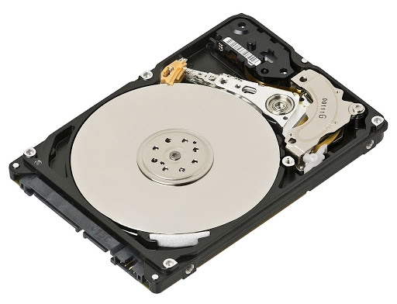
Hard disk
Is a magnetic storage medium for a computer.
When hard disk is firstly made in the factory, it is usually “blank”.
Only after partitioning tracks and sectors, we can save data on hard disk.

Slide 55
Data storage region of a hard drive
 | MBR (63) | DBR (32) | FAT1 | FAT2 | DIR(32) | DATA
INTIALS | Master Boot Directory | Dos Boot Directory | File Allocation Table 1 | File Allocation Table 2 | Directory | Data
DESCRIPTION | Stores partition table and bootloader | Contains boot code, BIOS Parameter Block (BPB), and FAT structure details | Maps file allocation and tracks used/unused clusters | Backup copy of FAT1 for redundancy | Stores metadata (filenames, attributes, timestamps) for files and directories | Holds actual file contents, organized into clusters
SIZE | 512 bytes | 512 bytes | Varies (depends on partition size) | Same as FAT1 | Fixed size in FAT12/16, dynamic in FAT32 | Remaining space on the disk

Slide 56
File deletion
When deleting a file, the system only makes a deletion mark on this file’s directory entry, marking clusters it covers in FAT as “empty”; clusters in DATA remains original file’s contents.
There is a Recycle Bin in Windows, which automatically establishes a folder "RECYCLED" (under root directory of each disk partition) with hiding attribute to save temporarily deleted files.

Slide 57
File deletion (continues…)
Fast Deletion
Is just to put them into Recycle Bin.
In this situation, the data can be recovered.
Complete Deletion
Refers to the process of permanently removing a file from a storage device, where the data is completely overwritten, making it virtually impossible to recover using standard data recovery tools.

Slide 58
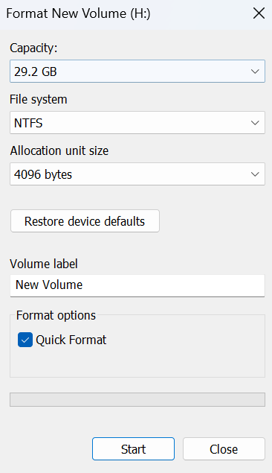
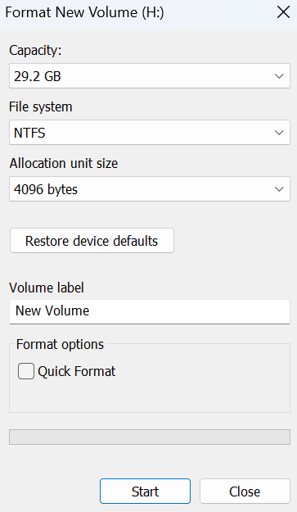
HIGH LEVEL Formatting
Fast high level formatting
Complete high level formatting

Slide 59
FAT VS. NTFS
 | File Allocation Table (FAT) | New Technology File System (NTFS)
Developed By | Microsoft (1977) | Microsoft (1993)
Maximum File Size | 4GB (FAT32), 2GB (FAT16) | 16TB (with default cluster size) or 256TB
Maximum Volume Size | 2TB (FAT32), 4GB (FAT16) | 8PB (Petabytes) or 256TB
Security Features | None (Basic file attributes) | Supports file encryption and access control (ACLs)
Performance | Slower for large files | Faster due to file compression and indexing
Used in | USB drives, memory cards, older systems | Modern Windows systems, SSDs, enterprise storage

Slide 60
Deletion techniques
Multiple Overwrites
Extreme Physical Destruction
Chainsaws
Drop in a volcano
Sledge hammers

Slide 61
Hard disk drive (hdd)
Lecture 4

Slide 62
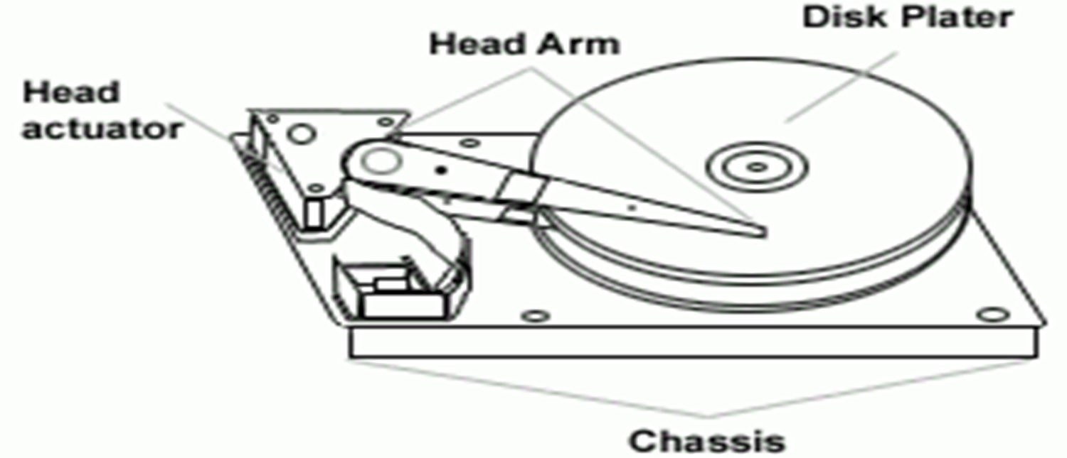
Main components for Hard disk drive
HDD were invented in 1954 by IBM.
It’s main components include –

Slide 63
Main components for Hard disk drive (Continues…)
Disk Platter – is made up of a magnetic material, in the flat disk part of the drive and it stores data.
Stepper Motor – is used for controlling read/write head position.
Spindle Motor – controls the platter.

Slide 64
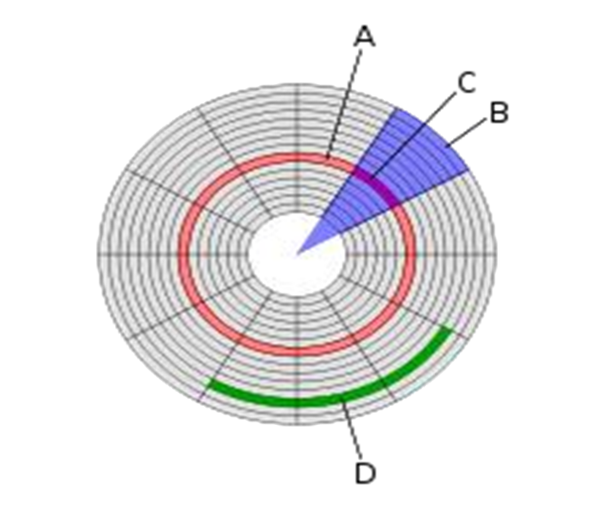
READ AND WRITE HEAD
The heads read and write the information to the drive platter.
The head arm is used for read and write operations.
Below is a disk structure –
Track
Sector
Cylinder
Storage Capacity

Slide 65
Partition for HDD
Primary Partition – used to boot the operating system.
Extended Partition – can be subdivided into multiple logical partitions.
Logical Partition –
Active Partition –

Slide 66
TYPES OF INTERFACEING IN HDD
Integrated Device Electronics (IDE) – also known as Parallel Advanced Technology Attachment (PATA).
Serial Advanced Technology Attachment (SATA) – It is the latest high-speed type of hard drive connectors.
Small Computer System Interface (SCSI) –

Slide 67
HDD Capacity and Size Information
Term | Equal To
Bit | 0 or 1
Kilo Bit (kb) | 1024 bits
Byte | 8 bits
Kilobyte (KB) | 1024 bytes
Megabyte (MB) | 1024 kilobytes
Gigabyte (GB) | 1024 megabytes
Terabyte (TB) | 1024 gigabytes
Petabyte (PB) | 1024 terabytes
Exabyte (EB) | 1024 petabytes
Zettabyte (ZB) | 1024 exabytes
Yottabyte (YB) | 1024 zettabyte

Slide 68
Multi-Media Forensics
Lecture 5.1

Slide 69
Classification of multimedia
Text - ASCII/Unicode, HTML, PDF
Audio – Sound, music, speech
Still Image - photo, scanned image
Video (Moving Images) – Movie
Graphics – Computer produced image
Animation – A sequence of graphics images
Discrete Media (DM, Static) – text, image, graphics
Continuous Media (CM, Dynamic) – audio, video, animation
Captured vs Synthesized media
Standalone vs Networked media

Slide 70






multimedia
Multimedia is a combination of text, sound, graphics, video, and animation delivers by computer or any other electronic media.

Slide 71
Use area of Multimedia
Business – application for multimedia include presentation, Training, advertisement, video, conferencing and etc.
Education – Multimedia is a better form of teaching in schools and colleges.
Home
Public

Slide 72
Elements of multimedia
Text – can have different font and size to suit the presentation.
Image – It is the most important and interesting component of multimedia.
Sound – It is categorized by frequency ,web length, amplitude, speech etc. Mono uses a single audio channel and applied in public address systems e.g., podcasts, while stereo uses two channels (left and right) and applied in music, movies, video games etc.
Animation – animation makes static presentations come alive.
Video – It is the technology of capturing, recording, processing, transmitting, and reconstructing moving pictures.

Slide 73
Multi-Media Forensics
(Audio & Video)
Lecture 5.2

Slide 74
Introduction
Unlike other forms of forensic evidence, audio and video recordings can provide a real-time, eyewitness account at a crime so investigators can watch or hear what transpired.
Authentication of recordings –
Lighting conditions can be examined to estimate the time of day or environmental conditions at the same time of the recording.
Unnatural waveform present in the audio or video signal may indicate that an edit has been made.

Slide 75
Types of video and audio
Digital
Half of all Closed-Circuit Television (CCTV) evidence seized by the police today is digital.
Digital video recorders come in two general types, embedded stand-alone and PC-based, both types generally record the audio and video to Hard Drives, Secure Digital (SD) cards.
Digital video and audio recording devices include CDs/DVDs and USB.

Slide 76
Types of video and audio (Continues…)
Analog
Every playback of the tape will degrade the recorded images.

Slide 77
Important evidence to be recorded
Make and model of the recording device.
How many cameras are connected and recording.
Whether it is recording in time-lapse mode.
The current time/date, and the time/date on the recorder’s display
Cameras’ positions.

Slide 78
Who Conducts the Analysis
American Society of Crime Laboratory Directors / Laboratory Accreditation Board differentiates the audio and/or video analysis into four parts –
Forensic audio analysis
Forensic video analysis
Image analysis
Computer forensics

Slide 79
How the analysis is performed
First step is to simply listen to or view the recorded footage.
Locate the area of interest to be enhanced or examined using specialized devices and software.
Before processing a working copy of the evidence may be created.

Slide 80
Video Enhancement Technique
Sharpening – Makes edges of images in the recording become more clear and distinct.
Stabilization – Reduces the amount of movement in the video, producing the smoothest possible playback.
Masking – Covers the face or areas of the video that may protect a witness, victim or law enforcement officer.
Demultiplexing – Allows for isolation of each camera.

Slide 81
Audio Enhancement Techniques
Frequency Equalization – Highly precise equalizers can be used to boost (using amplification) or cut specific bands of frequencies and high noisy sound can be analyzed by a spectrum analyzer.
Compression – Faint sounds in the recording can be boosted by compressing.

Slide 82
Malware Forensics
Lecture 6

Slide 83
Malware
The word MALWARE comes from the combination of Malicious and Software.
In Spanish, ‘MAL’ is a prefix that means, ‘BAD’ , making the term ‘bad ware’.
Malware is program that is specifically designed to gain access or damage a computer without the knowledge of the owner.
It’s purpose include stealing, encrypting, deleting, altering and monitoring user data.

Slide 84
History of Malware
People first started writing malware in the 1970s and early 1980s. They were written as experiments or pranks for fun.
‘Creeper Virus’ created in 1971 was an experiment which did not cause damage but did foretell the future of malware with its quick spread through systems.
‘Reaper’ was created to hunt and destroy Creeper, one of the first examples of an ‘anti-virus’ program.
Term ‘malware’ was coined in 1990 and its use increased in the early 2000s.

Slide 85
Distribution or Infection Methods of a Malware
Delivered physically to a system through a storage media device such as an USB drive.
Drive-by-Downloads via the Internet.
Spam E-mails and Phishing Attacks.
Bundled with other software.
Accessing hacked or compromised webpages.

Slide 86
The 5 STAGEs OF MALWARE ATTACK
.
Entry
Execution
Distribution
Infection
Exploit

Slide 87
TYPES OF MALWARE
Virus
Is a computer program that infects a host computer and then spreads when executed.
Boot Sector – infects the boot sector of disk storage (MBR).
Macro – exploits the macro language of a program like Microsoft Word or Excel.
Logic/Time Bomb – malicious code embedded in a program that executes when certain conditions are met.

Slide 88
TYPES OF MALWARE (Continues…)
Worms
are very similar to a virus, but it can send copies of itself to other nodes on a computer network without having to be carried by an infected host file.
Email – spreads itself through an email and can hide itself in messages as a link or an attachment that will redirect the user to an infected website.
Instant Messaging – a link that will redirect the user to an infected website will be shared though an IM like WhatsApp.

Slide 89
TYPES OF MALWARE (Continues…)
Trojan Horse
is a program that appears harmless, but is, in fact, malicious.
Remote Access Trojans (RATs) – allow attackers to take control of the victim’s computer remotely.
DDoS Trojans – turn infected machines into bots to flood target servers.

Slide 90
TYPES OF MALWARE (Continues…)
Rootkit
It is a computer program designed to provide continued privileged access to a computer while actively hiding its presence.
Originally, a rootkit was a collection of tools that enabled administrator-level access to a computer or network.

Slide 91
TYPES OF MALWARE (Continues…)
Fake Antivirus Trojans (Scareware)
is a type of malware designed to trick victims into purchasing and downloading useless and potentially dangerous software.

Slide 92
TYPES OF MALWARE (Continues…)
Ransomware
Is a type of malicious software (malware) that encrypts a victim’s files or locks their system, making data inaccessible until a ransom is paid, usually in cryptocurrency (e.g., Bitcoin).
Originated in Russia, 2005-2006.
Types of Ransomware include;
Crypto-ransomware (2013) – Encrypts files (e.g., WannaCry, Locky, CryptoLocker).
Locker Ransomware – Locks access to the computer (e.g., WinLocker).
Double Extortion – Steals data before encryption and threatens to leak it if ransom isn't paid (e.g., Maze, REvil).

Slide 93
TYPES OF MALWARE (Continues…)
How It Works
Infection – Often spread via phishing emails, malicious links, or infected downloads.

Slide 94
TYPES OF MALWARE (Continues…)
Spyware
is a program that get installed without the user’s permission to monitor the user’s activities on the internet and transmit the information to the third party.
Types include;
Tracking cookies
System monitors
Commercial cell phone spywares
Keyloggers

Slide 95
TYPES OF MALWARE (Continues…)
Adware
is a software where advertising banners are displayed while any program is running.

Slide 96
Protecting Against Malware
Anti-malware/virus software
Are computer programs intended to identify and eliminate computer viruses.
For example, Microsoft Security Essentials (for Windows XP, Vista, and Windows 7) and Windows Defender (for Windows 8, 10 and 11) provides real-time protection.
The Windows Malicious Software Removal Tool removes malicious software from the system.

Slide 97
Protecting Against Malware (Continues…)
Example of anti-virus softwares include;
BitDefender
Norton AntiVirus (NAV)
McAfee
Sophos
Kasperski

Slide 98
Protecting Against Malware (Continues…)
Types of anti-virus
Specific Scanning (signature detection)
The application scans files to look for known viruses matching definitions in a “virus dictionary”.
After recognizing the malicious software the antivirus software can take one of the following actions;
Repair, quarantine or delete the file completely.
A signature-based is completely blind to new attacks that are yet to be recorded.

Slide 99
Protecting Against Malware (Continues…)
Generic Scanning (suspicious behavior approach)
is used when new viruses appear, in this method the software does not look for a specific signature but instead monitors the behavior of all applications.
If anything questionable is found by the software the application is quarantined and a warning is broadcasted to the user about what the program may be trying to do.
If the software is found to be a virus the user can send it to a virus vendor so that they release the antivirus software to stop its spread.

Slide 100
Cloud Forensics
UNIT 7

Slide 101
Types of Clouds
Cloud computing is a technology that uses the internet and central remote servers to maintain data and applications.
Types of cloud include;
Public – The cloud is open to the wider public.
Private – The cloud is implemented within the private premises of an institution.

Slide 102
Types of Clouds (Continues…)
Hybrid/Heterogeneous – A combination of both Public and Private clouds.
Community – The cloud is characterized by a multi-administrative domain involving different deployment models (public, private, and hybrid), and it is specifically designed to address the needs of a specific industry.

Slide 103
Cloud Service Models
Service Model | Who Uses It | Available Services | Why Use It
SaaS | Agency Staff Members | Software applications such as email | Complete business tasks that are typically performed locally on a computer
PaaS | Developers and Application Managers | Service for creating, testing, managing, and hosting software applications | Establish a common and consistent platform for application development
IaaS | IT System Managers | Virtual machines, storage and backup services | Build a customized computing environment

Slide 104
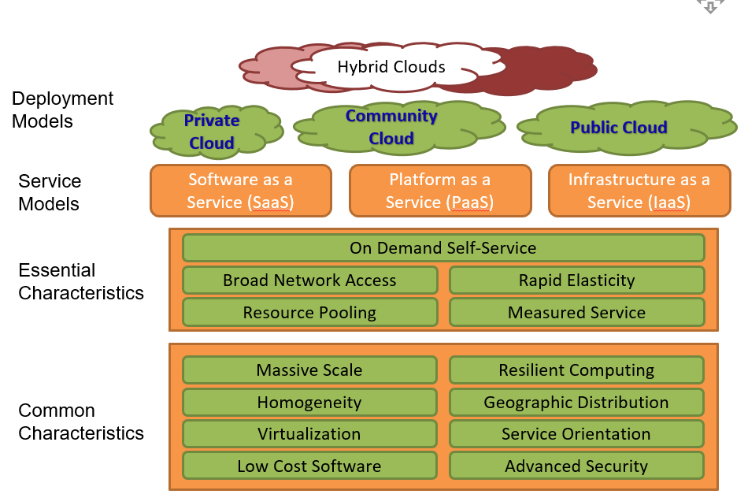
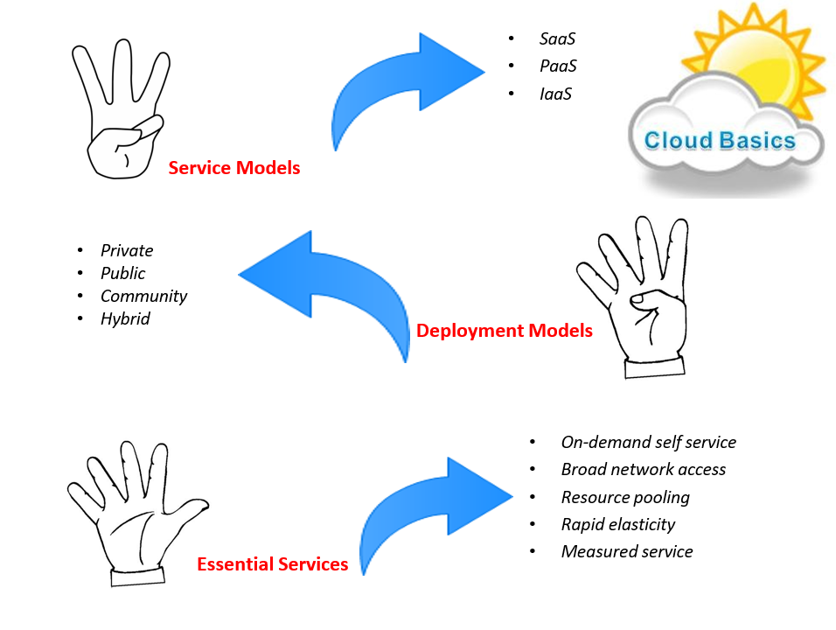
Cloud Computing Framework

Slide 105
Forensics
Digital forensics involves the collection, preservation, and analysis of digital evidence.
Cloud forensics is the application of digital forensics science in cloud computing environments.
Technically, it consists of a hybrid forensic approach (e.g., remote, virtual, network, live) towards the generation of digital evidence.
Organizationally, it involves interactions among cloud actors (i.e., cloud provider, consumer, broker, carrier, auditor) for the purpose of facilitating both internal and external investigations.
Legally, it often implies multi-jurisdictional and multi- tenant situations.

Slide 106
Actors in Cloud Computing
Consumer – A person or organization that maintains a business relationship with, and uses services from the Cloud Providers.
Provider – A person, organization, or entity responsible for making a service available to interested parties.
Auditor – A party that can conduct independent assessment of cloud services.
Broker – An entity negotiates relationships between Cloud Providers and Cloud Consumers.
Carrier – An intermediary that provides connectivity and transport of cloud services from Cloud Providers to Cloud Consumers.

Slide 107
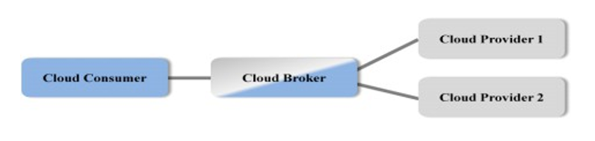
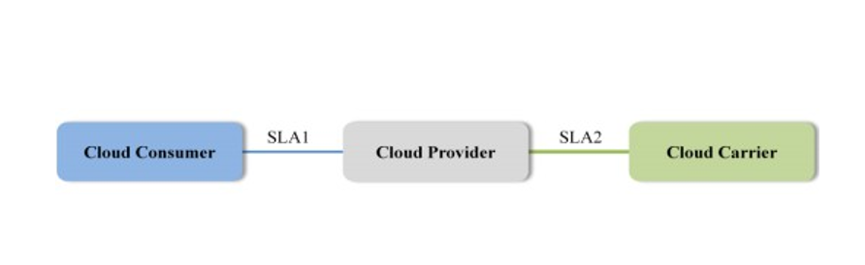
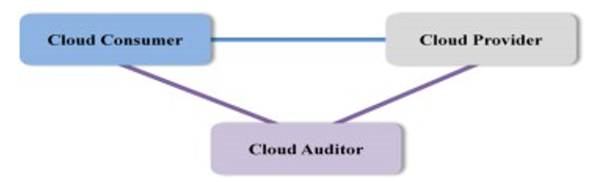
Scenarios in Cloud
Scenario 1
Scenario 2
Scenario 3
Cloud consumer interacts with the cloud broker instead of contacting a cloud provider directly.
Cloud carriers provide the connectivity and transport of cloud services from cloud providers to cloud consumers.
Cloud auditor conducts independent assessments for the operation and security of the cloud service.

Slide 108
Actors in Cloud Computing (Continues…)
Service Level Agreements (SLAs) cover the quality of service, security, remedies for performance failures.
Cloud Providers offer services like SaaS, PaaS and IaaS.
Audits are performed to verify conformance to standards.
Integration of cloud services can be complex for consumers. Hence cloud broker, is needed.

Slide 109
Actors in Cloud Computing (Continues…)
In general, a cloud broker can provide services in three categories:
Service Intermediation – broker (a third-party service or system) stands between the consumer and the actual service provider to enhance or improve the service being delivered.
Service Aggregation – Broker combines and integrates multiple services into one or more new services (mash up).
Service Arbitrage – It is similar to service aggregation with the flexibility to choose services from multiple agencies.

Slide 110
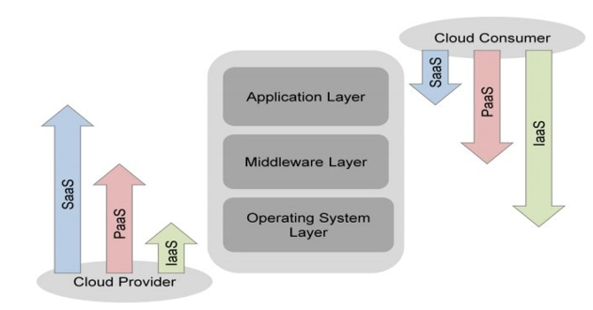
Actors in Cloud Computing (Continues…)
The distribution of cloud services is normally provided by network and telecommunication carriers or a transport agent.
Transport agent refers to a business organization that provides physical transport of storage media such as high-capacity hard drives.

Slide 111
Memory Forensics
Lecture 8

Slide 112
INTRODUCTION
While a system is on, Random Access Memory (RAM) contains critical information about the current state of the system.
By capturing an entire copy of RAM and analyzing it on a separate computer, it is possible to reconstruct the state of the original system, including the applications the user was running and the files or network connections that existed at the time.
Processes, files and programs are run in memory (volatile information), and a snapshot (memory dump) can be captured by a forensic investigator.

Slide 113
WHAT IS MEMORY FORENSICS?
Memory forensics refers to finding and extracting forensic artifacts from a computer’s physical memory.
Below are some differences between memory forensics and disk forensics.
Feature | Memory Forensics | Hard Disk Forensics
Image | Snapshot (memory dump) | Disk image and mostly used for data revery
State | Live response | Post mortem
Volatility | Data is volatile and can be lost when the machine is powered off | Non-volatile data

Slide 114
WHY MEMORY FORENSICS?
Hiding Data – Attackers may hide data in the memory by means of memory injection and it only resides in memory not hard disk.

Slide 115
DATA ACQUISITION METHODS IN Memory Forensics
Hardware-based acquisition
Suspends the processor and uses direct memory access to obtain a copy of memory when the PCI card is plugged in the computer system and a copy of the memory is transferred to an external storage device.
The card is installed into a PCI bus slot before an incident occur.
It is more reliable and difficult for an attacker to corrupt, however, they are costly.

Slide 116
DATA ACQUISITION METHODS IN Memory Forensics (Continues…)
Software-based acquisition
Is often carried out using a trusted toolkit by forensic examiners.
This method can also collect volatile memory content using tools built in the operating system.
Drawbacks of software-based acquisition are that it may alter contents of memory, and potentially overwrite data relevant to an investigation.
However, they are cost-effective.

Slide 117
FORMATS OF DATA ACQUIRED IN Memory Forensics
RAW – extracted from a live environment.
Crash Dump – information gathered by the operating system.
Hibernation File – a saved snapshot that your operating system can return to after hibernating.
VMWare Snapshot – this is a snapshot of a virtual machine, which saves its state as it was at the exact moment that the snapshot was generated.
Page File – this is a file that stores similar information that is stored in your system RAM.

Slide 118
MEMORY FORENSIC TOOLS
Volatility Suite – is an open source suite of programs for analyzing RAM, and has support for Windows, Linux and MacOS.
Rekall – This is an end-to-end solution for incident responders and investigators, and features both acquisition and analysis tools.
Helix ISO – This is a bootable live CD as well as a standalone application that makes it very easy for you to capture a memory dump or memory image of a system.
Belkasoft RAM Capturer – This is another forensic tool that allows for the volatile section of system memory to be captured to a file.

Slide 119
These notes are 85% done, you are advised on check the handout of cloud forensics and the need for memory forensics.

